Slide 1

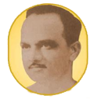
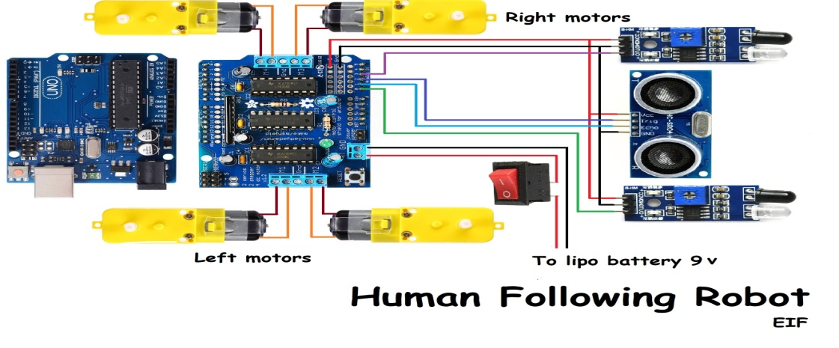
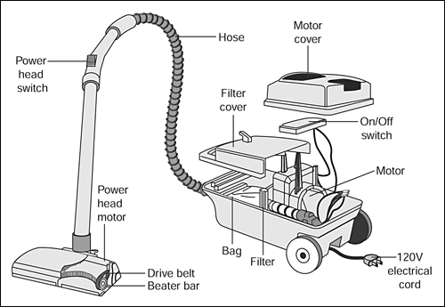
 | Anantrao Pawar College of Engineering & Research ,Pune INTERNET OF THINGS CONTROLLING ROBOT BY USING GOOGLE ASSISTANT ,BLUETOOTH AND VOICE COMMAND Mentor: Prof. Anil Lohar Academic Year:2023-24 Magar Swapnil, Pavan Kawade, Patil Nikhil ,Sawant Shivaji
Introduction
Robot Platform: The heart of the project is a robot platform equipped with motors and wheels for movement, and a Bluetooth module for wireless communication. Microcontroller: A microcontroller, such as Arduino or Raspberry Pi, serves as the brain of the robot. It processes incoming voice commands, controls the robot's movements, and manages the Bluetooth communication.
Objective
Voice-Activated Control: Enable users to control the robot through voice commands, creating an intuitive and hands-free interaction. Integration with Google Assistant: Utilize Google Assistant's voice recognition capabilities to understand and process user commands effectively. Bluetooth Connectivity: Establish a stable Bluetooth connection between the user's device and the robot's microcontroller to enable real-time communication.
Methodology
Working Model
Software Requirements
Voice Recognition Software Mobile App Arduino NLTK (Natural Language Toolkit) Robot Control Software
Conclusion
This model is implemented by using IOT device to avoid complexity and gain more accuracy and This project has proved a way for problem identification it’s management and providing a reliable solution for the same.
References
C.o. iRobot, ‘‘iRobot:Our History,” 29 May 2015. [Online]. Available: M. M. Bijaieh, W. W. Weaver, and R. D. Robinett, “Effects droop settings on energy storage systems of inverter-based microgrids,” Electrical Drives, Automation and Motion pp. 75–80, June 2018.

